Slide 1
Arduino Workshop #10
Interfacing with liquid crystal displays
Notes:
24 - Arduino Uno
24 - USB cables
24 - Speakers
48 - pushbuttons
24 - Small DC fan
24 - 16x24 character LCD
48 - 4.7 ㏀ resistor
48 - 10 ㏀ resistor
24 - 150 Ω resistor
24 - 10 ㏀ POT
24 - TC74A0-0.5V I²C Temperature sensor
24 - jumper wire sets
24 - breadboards

Slide 2
Setting up the LCD
We will be using pre soldered 16x2 LCDS
If after this you choose to purchase a LCD fpr a project know that some come w/o the headers soldered on
16x2 refers to the number of columns and rows the LCD displays
16 columns
2 rows

Slide 3
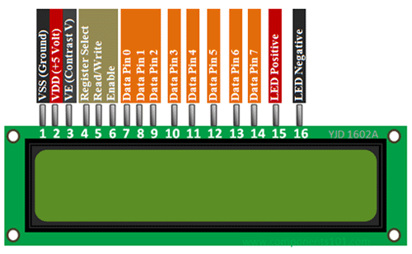
Looking at the pin out

Slide 4
Breaking down the pins
Pin 3 (contrast) - controls how dark the display is. It connects to the center pin of our POT
Pin 4 (RS) - sets the LCD to command or character mode
Based on its state the LCD is either interpreting data as a command or a character
Pin 5 (RW) - tied to ground
indicating we will only ever be writing to the LCD not reading from it
Pin 6 (EN) - used to tell the LCD when data is ready
Pins 7 to 14 - used to transmitting data
Usually labeled D0 to D7 (in order)
pins 7 to 10 (D0 - D3) will be unused by us
Pin 15 and 16 - run the back light
Connect them to 5v (pin 15) and ground (pin 16) with a current limiting resistor as needed

Slide 5
Connecting to the arduino
You can connect the communication pins on the LCD to any I/O pins on the arduino
To be consistent with the group we will use
LCD Pin | Arduino Pin
RS | Pin 2
EN | Pin 3
D4 | Pin 4
D5 | Pin 5
D6 | Pin 6
D7 | Pin 7

Slide 6
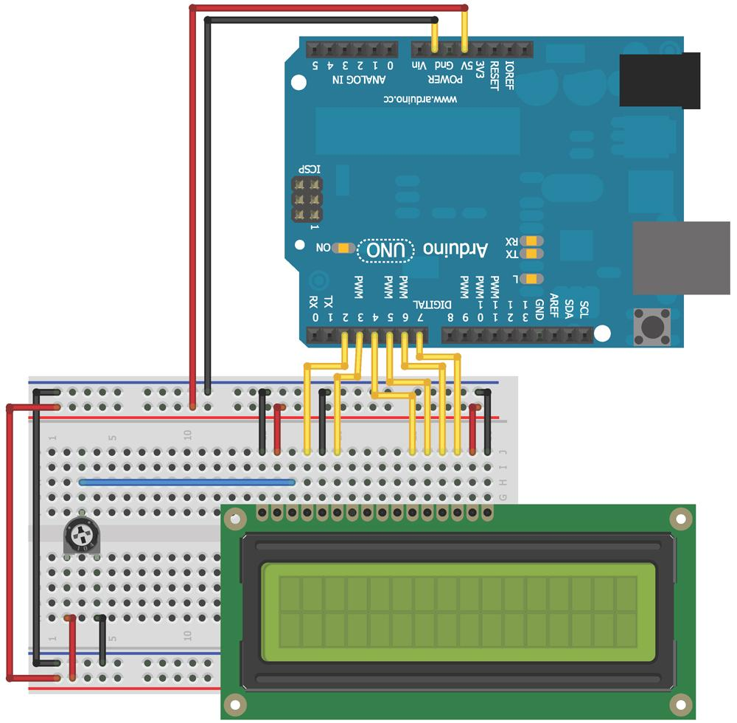
Lets wire up the LCD

Slide 7
Using the LiquidCrystal Library
The Arduino IDE includes the LiquidCrystal library
It includes simplified functions to
Blinking the cursor
Automatically scrolling text
Creating custom characters
Changing direction of printing
Many other useful additions and functions
You can find description of the library function as well as examples of use at
http://arduino.cc/en/Reference/LiquidCrystal

Slide 8
Adding text to the display
The first thing we will be doing in order to learn the basic operation of the LCD is to add text and an incrementing number to the display
To initialise the LCD we use the following code
#include <LiquidCrystal.h>
Initiallizes the liquid crystal library
LiquidCrystal lcd (2,3,4,5,6,7);
This creates a liquid crystal obj named lcd and the arguments represent the pins connected (RS,EN,D4,D5,D6,D7 in that order)
lcd.begin(16,2)
This sets the LCD display character size as a number of rows and col respectively
lcd.setCursor(0,1)
This moves the cursor to a specific spot
Columns and rows are indexed (0,0) in the top-left
lcd.Print(“We love EE”)
This will print what ever characters you supply (as a char and that will fit in the dimensions of the LCD)

Slide 9
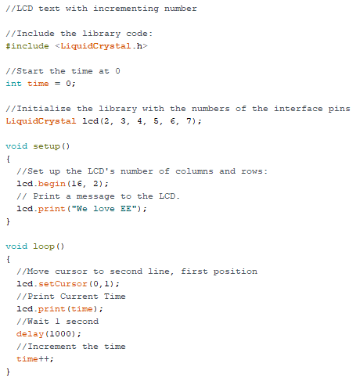
Adding it all to a sketch
You should see your message with a counter increasing every second

Slide 10
Creating Special Characters or Animations
If you want special characters, degrees sign, greek letters - the LiquidCrystal library supports the definition of custom Characters
To create a custom character
You will notice each character block is really made up of a 5x8 grid of pixels
You simply define the value of each of these pixels and send that information to the display

Slide 11
Demonstration of this concept
We will make a series of characters that will fill the second row of the display with an animated progress bar
Each space is 5 pixels wide
So there will be 5 custom characters
1st column filled
1st & 2nd col filled
Etc.
We will use binary to encode the state of the pixel (1 is on 0 is off)

Slide 12
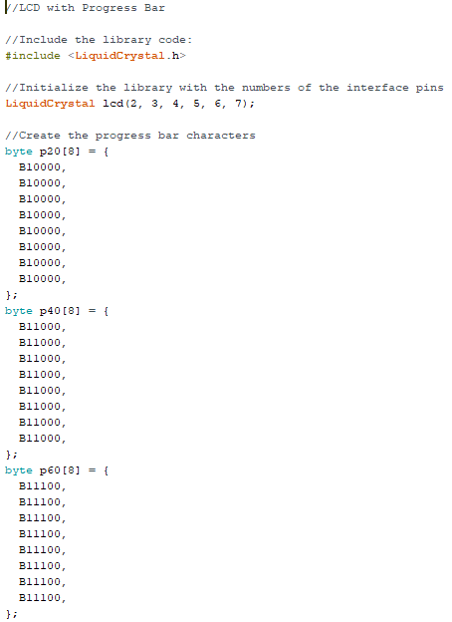
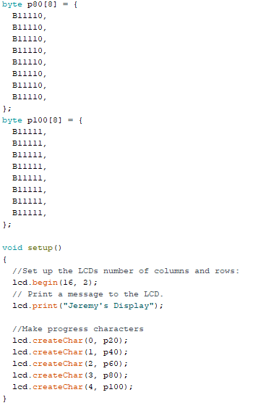
Defining your special caharacters

Slide 13
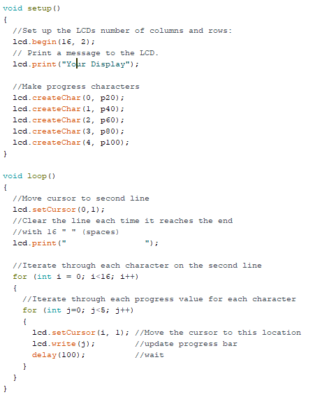
Implementing them in your code

Slide 14
Building a personal thermostat

Slide 15
Items we will use
A DC fan
If you want to add some oomph you can wire it with a transistor and external voltage supply (like session 4 shows), but hooking it to the 5V pins will show it spins when it should
Two buttons with 10 ㏀ pull - down resistors
A speaker
Connected to an I/O pin through a 150 Ω resistor and ground
We will set the frequency in the program
I²C temperature sensor
Hooked up exactly as we learned in lesson 8
To preserve space we will place this in front of the LCD’s potentiometer

Slide 16
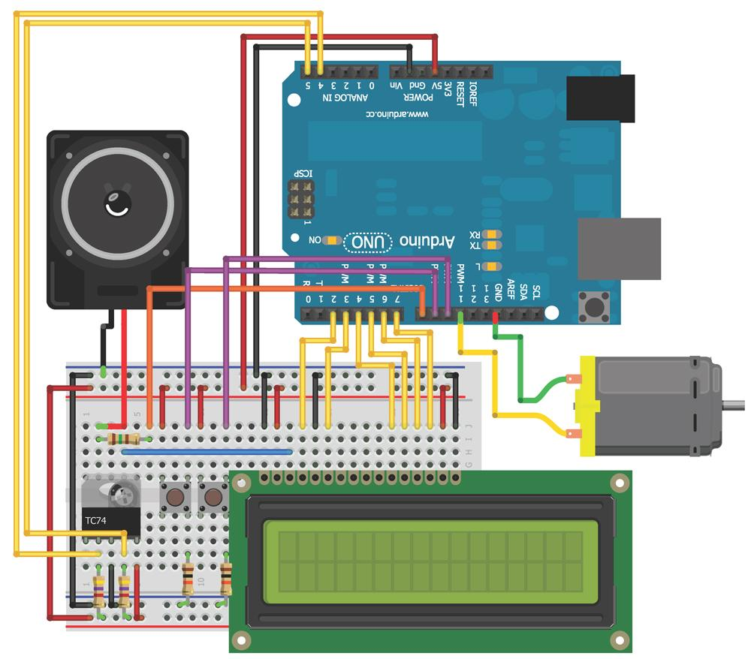
It should be wired like this

Slide 17
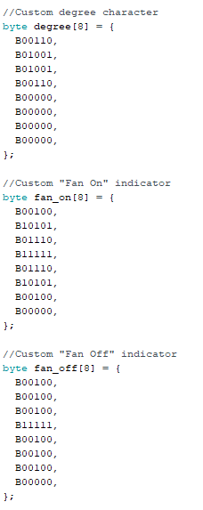
The custom characters

Slide 18
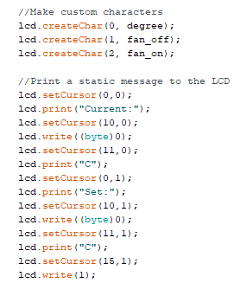
We will utilize them and refresh the screen as shown

Slide 19

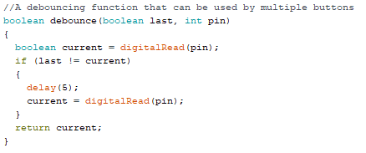
Adjusting the set point with buttons

Slide 20
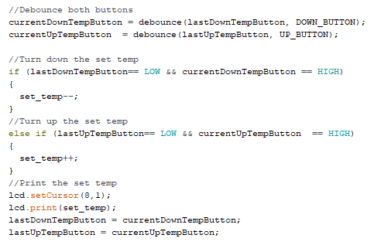
Updating the LCD
This code
first runs the debounce() function for each button and then adjusts the set temp variable if one button is pressed
Updates the LCD and button states

Slide 21
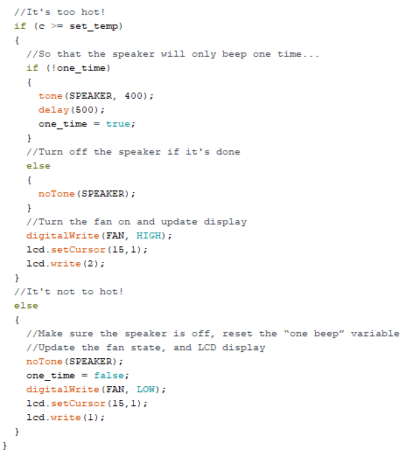
Adding audio warning and fan
Here we see
tone()
Paired to a delay() and notone() command
Using a state variable we determine if the speaker has beeped
And don't let it beep again until after the temp dips (and the state variable is reset)
When the fan turns on and indicator on the LCD changes

Slide 22
Bring it all together
You should now have a fully functioning code (combining all the snippets from earlier to all work together to produce the desired result)
Once you load the code onto the arduino you no longer need to have it connected to a computer to run, wou could take it and place it anywhere in the room to tell you the temperature (as long as you can connect it to a plug (or battery))

Slide 23
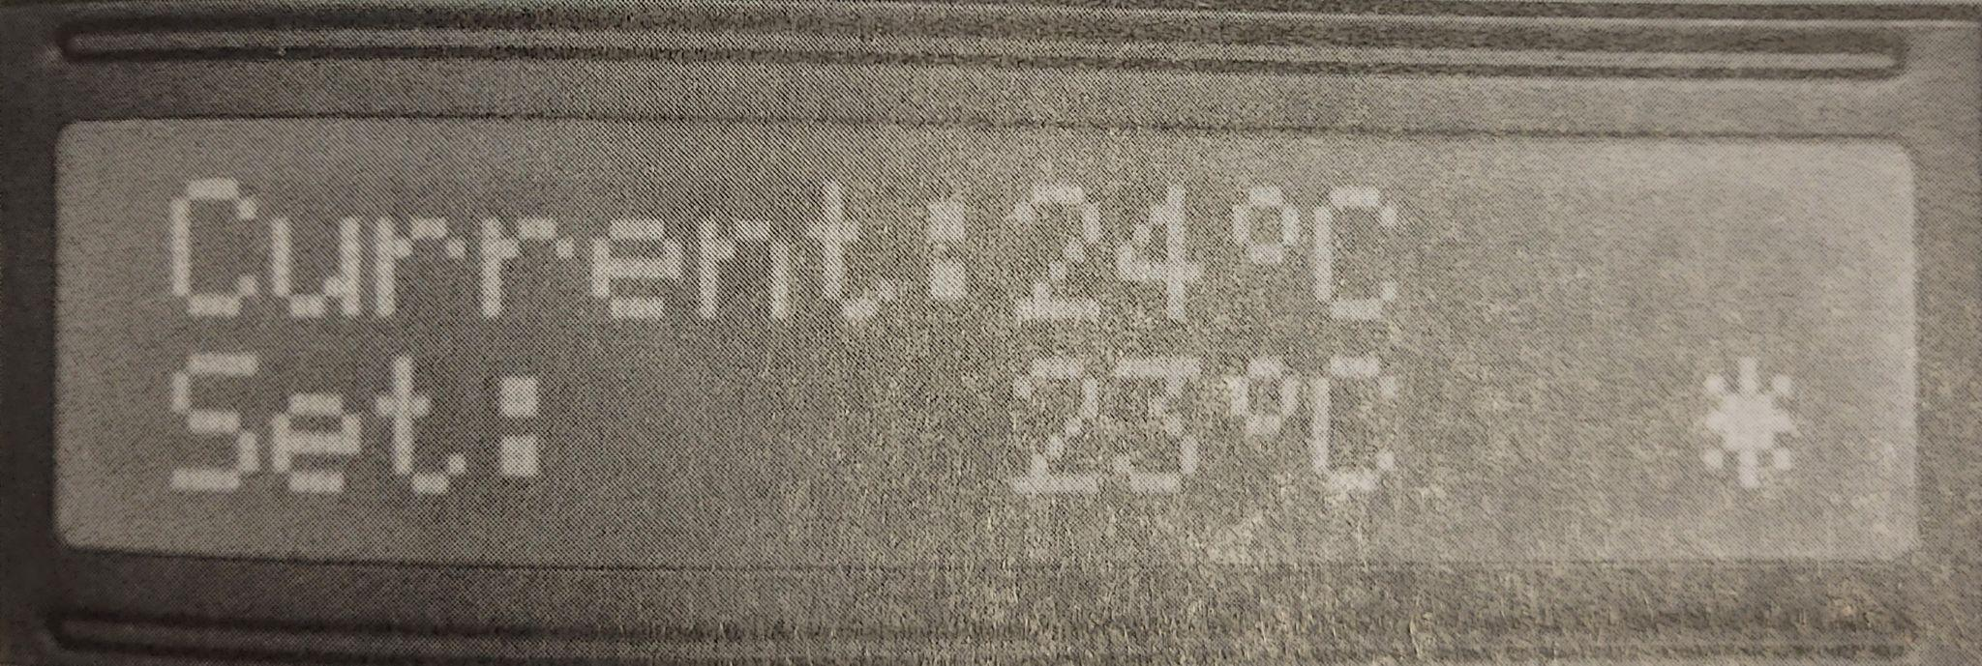
The LCD should look similar to this

